Slide 1
Predict the severity of an accident
Xue wenchang

Slide 2
Introduction
With the help of modern machine learning technology, people may be able to predict the severity given some basic information related to the accident so that police can better handle the accident when they arrive at the scene.

Slide 3
Data source
Data source is file Data-Collisions.csv downloaded from
https://s3.us.cloud-object-storage.appdomain.cloud/cf-courses-data/CognitiveClass/DP0701EN/version-2/Data-Collisions.csv

Slide 4
Data Analysis
We need to predict the severity of an accident based on some features.
Severity has two types: 1 and 2
From column “SEVERITYDESC”, we can know that “Injury Collision” corresponds to Severity code 2, and “Property Damage Only Collision” corresponds to Severity code 1.
We need to use other features to predict the severity of the accidents.

Slide 5
Data cleaning
Only keep the data whose "STATUS" is "Matched" since "Unmatched" data are unreliable
Only keep 'SEVERITYCODE', 'ADDRTYPE', 'INATTENTIONIND', 'UNDERINFL', 'SDOT_COLCODE', 'SPEEDING’ as key features for model construction
Fill empty cells and merge data whose meanings are the same.

Slide 6
Modeling
Sample Data is divided into 3 parts:
74% for training
20% for test
16%for validation
Tensorflow is used to construct a neural network
Feature layer
Dense layer (128)
Dense layer (128)
Dropout layer (.1)
Dense layer (1)

Slide 7
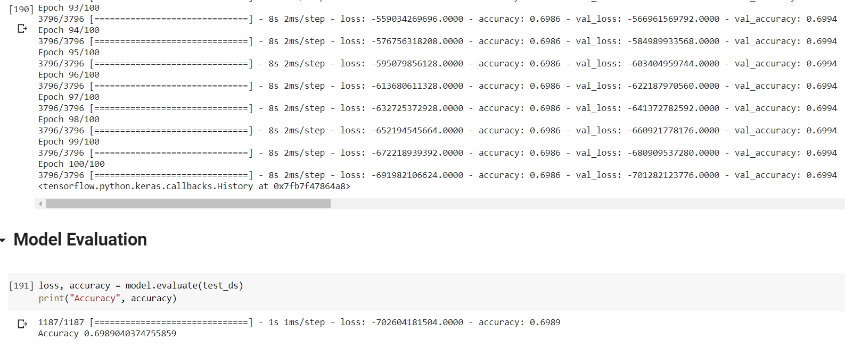
Results

Slide 8
Conclusion
The model is unable to converge
The accuracy of the model is close to the distribution of the data
The severity cannot be predicted with this machine learning strategy given the features selected.

